Slide 1




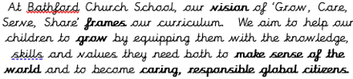
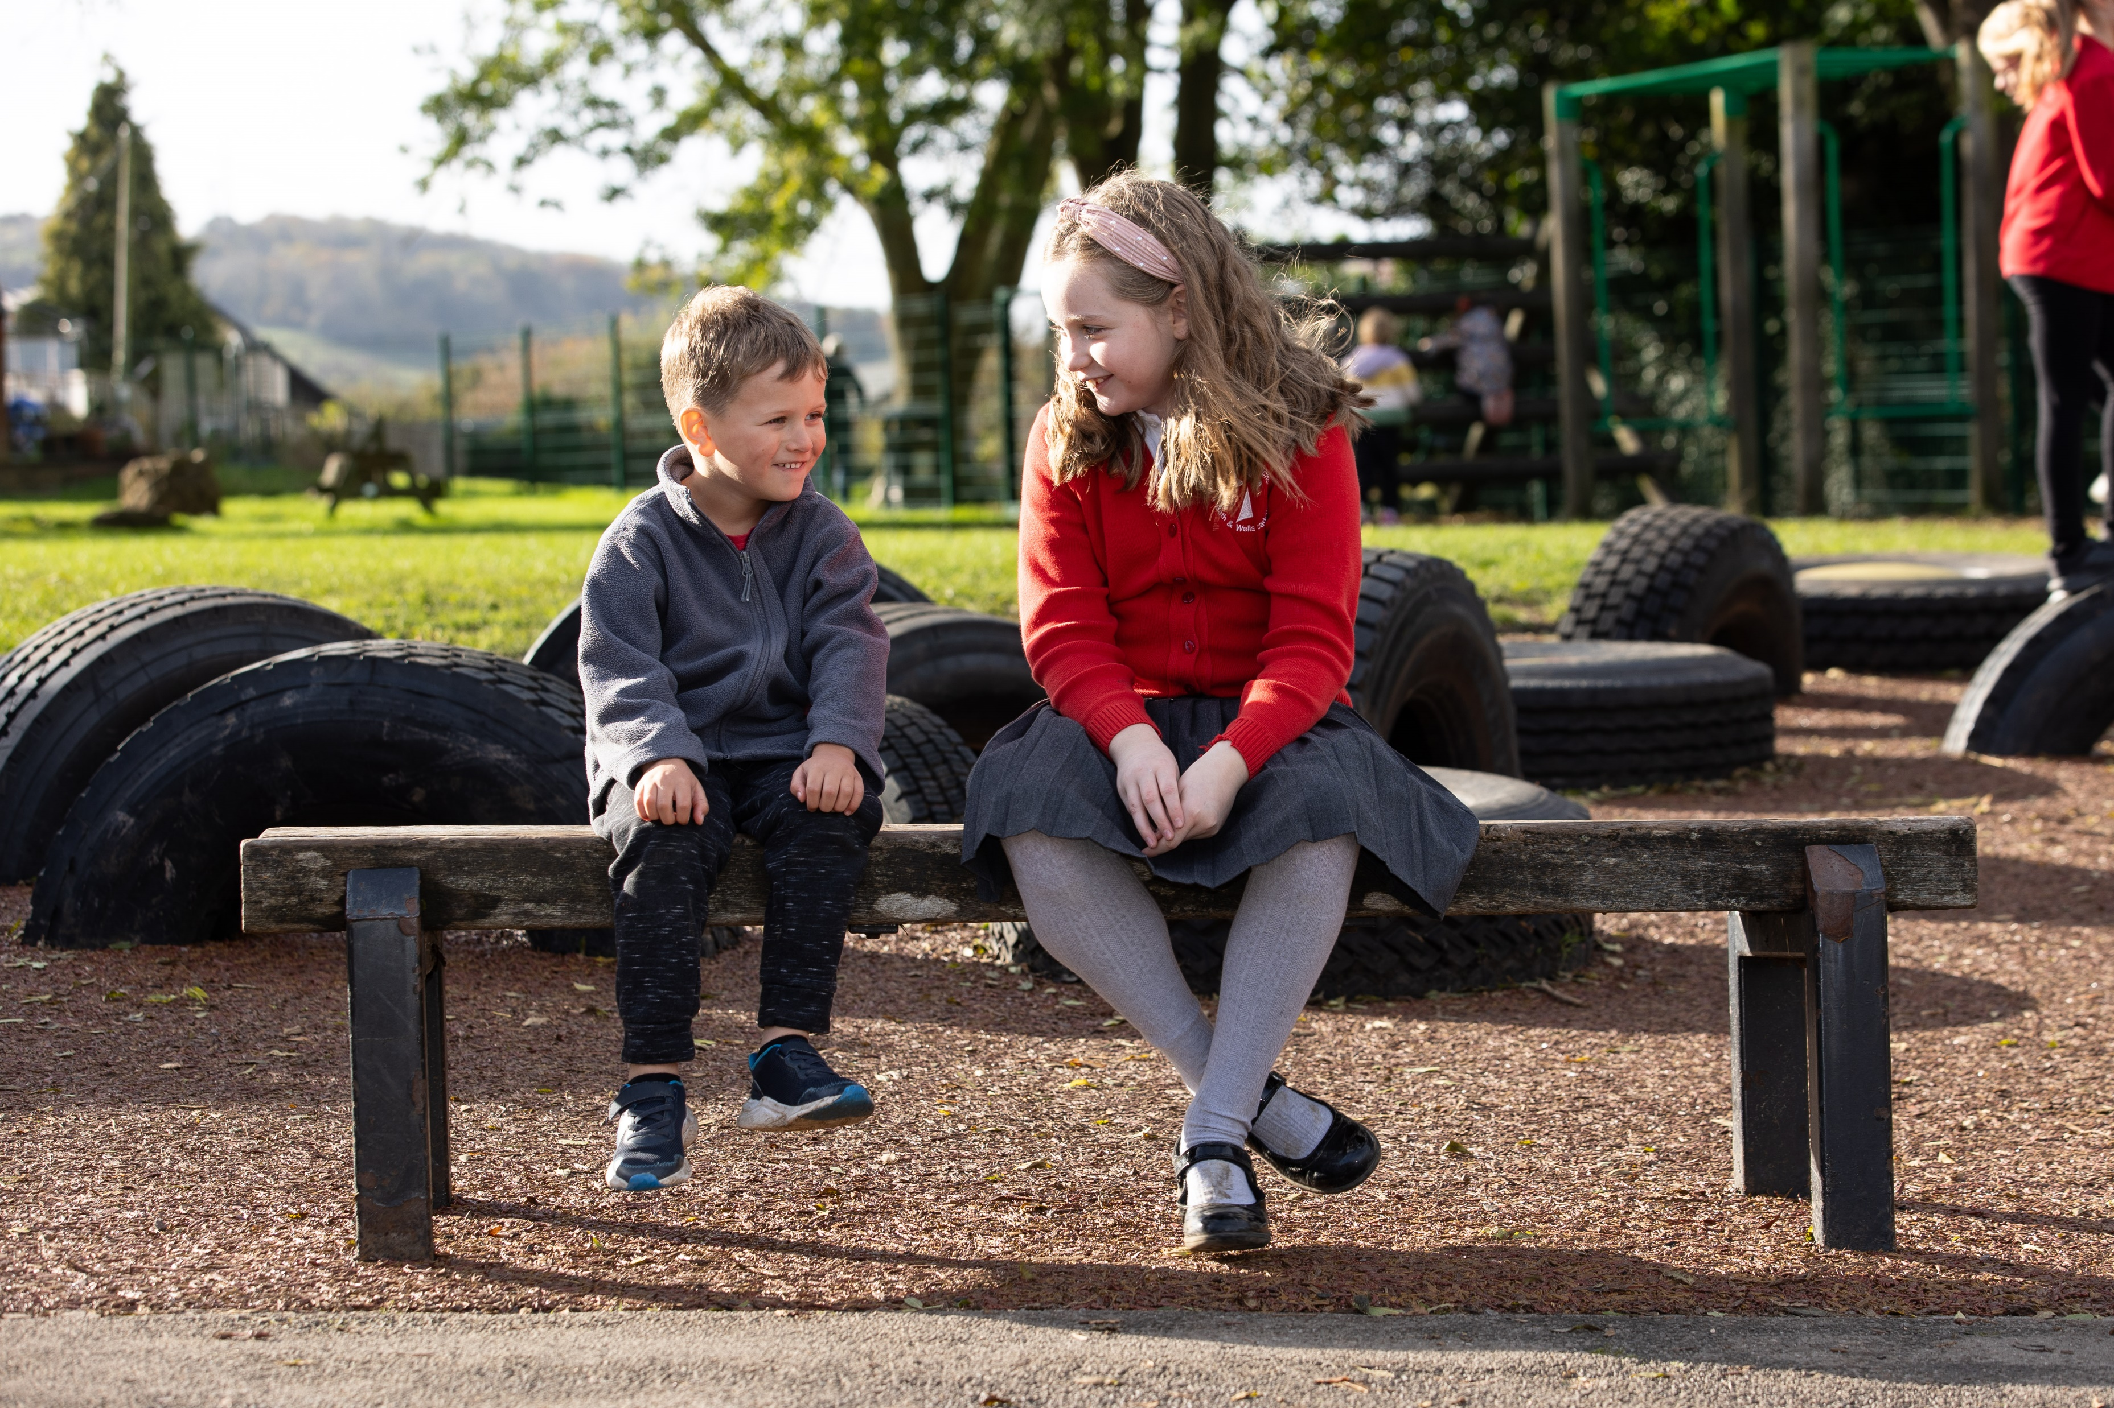
Bath and Wells Multi Academy Trust
Bathford Church School
School Development Plan Priorities 2026-2027
Bathford School Values
OUR STRATEGIC GOALS
Goal 1: Learners Experiencing Disadvantage
Goal 2: Raising attainment in writing
Goal 3: Quality of Education
To ensure all pupils benefit from consistently high-quality teaching through the successful embedding of the new class and subject-specialist teaching structure, while maintaining the school's warm curriculum principles of enquiry, creativity, real-life experiences and active engagement.
Goal 4: Personal Development, Wellbeing and SIAMS
To ensure all pupils flourish spiritually, socially and emotionally through the further development of collective worship, and spirituality and the school's Christian vision, enabling children to understand, articulate and live the values of Bathford Church School.
To ensure learners experiencing disadvantage continue to thrive academically, socially and emotionally through the successful implementation of the new class and subject-specialist teaching structure, achieving well from their starting points and participating fully in school life.
To ensure all pupils make strong progress in writing through the successful implementation of the revised writing curriculum, securing an appropriate balance of transcription and composition and enabling pupils to write with increasing accuracy, fluency and independence.
OUR SCHOOL VISION
BWMAT 5 PLEDGES
Our Education Strategy is built on ‘Seven Characteristics of Excellence’. Through co-production with schools, we have identified what we believe will make the biggest difference to children achieving the best. Reflective Leadership; Starting well together on their education journey; A curriculum for an ever-changing world; Teaching excellence along with inspired learning; The celebration of diversity and difference; An environment where physical and mental wellbeing encourages learning to flourish; Outward facing opportunities - looking beyond the horizon;
We know and believe if these key characteristics are at the forefront of everything we do, we will achieve excellence.

